Slide 1
Machine Learning
Owais Hussain

Slide 2
Activity
Objective 1: You will be shown a picture with no caption. You have to identify different objects from it.
Objective 2: Group the objects you identified into 2 categories.
Objective 3: Cross-compare your results with others.

Slide 3
Contents
Types!
Types simplified
Reinforcement learning
Neural Networks and LLMs
LLMs behind the curtains
Evolution of LLMs
Evolution of ChatGPT
Deepseek – the new bully in Town
Philosophical debate with Deepseek

Slide 4
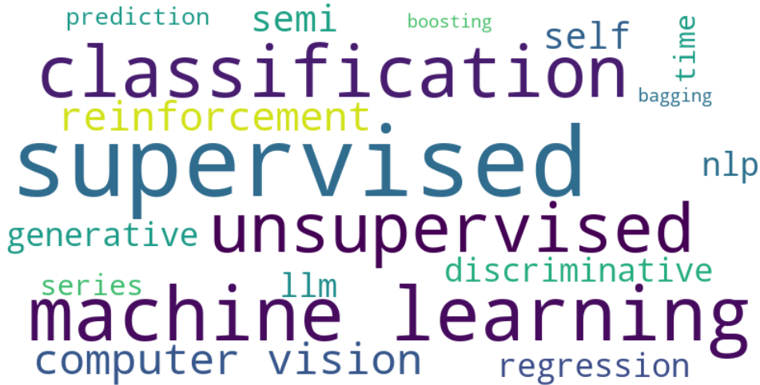
Types!

Slide 5
Supervised
Image Classification (CV)
Sentiment Analysis (NLP)
Speech Recognition
Credit Scoring, Fraud Detection (FinTech)
Unsupervised
Document Clustering (NLP)
Image Segmentation and Masking (CV)
Market Basket Analysis
Recommender Systems
Semi-Supervised
Object Recognition (CV)
Sentiment Analysis (NLP)
Reinforcement
Self-driving Cars
Game Bots
Autonomous Traders
Self-Supervised (LLMs)
Text Generation
Summarization
Question-Answering
Translation
Notes:
Disclaimer! I do not claim that this categorization is perfect. There are subtopics and subgroups that research community has different opinions about.

Slide 6
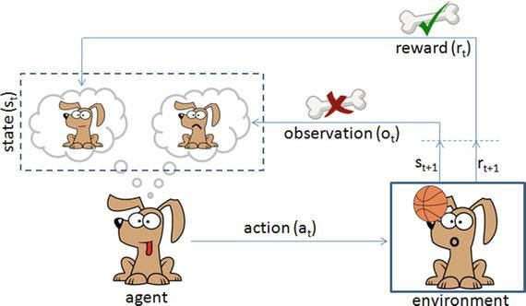
Reinforcement Learning
Reward based learning
AI Agent interacts with environment
+ points for right decisions
- points for wrong decisions
Trial and error focused
Exploration – try out new possibilities
Exploitation – reuse successful actions
Reinforcement Learning through Human Feedback (RLHF)
Cumulative learning for long-term goals.

Slide 7
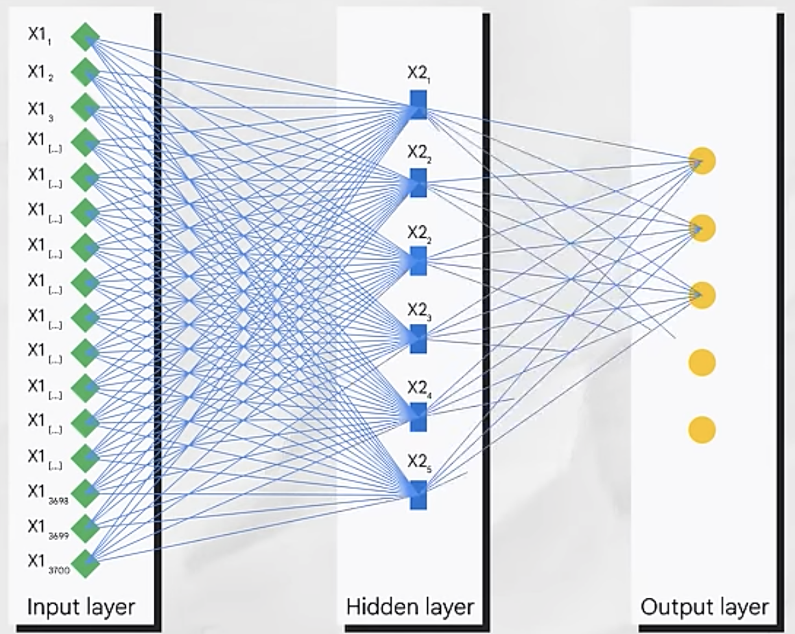
Neural Networks and LLMs
Artificial Neural Networks (NN) mimic the operation of human brain
Semi-supervised learning to use labelled and unlabeled data.
Self-refinement and transfer learning from layer to layer.
LLMs are NN’s that predict the probability of sequence of words.

Slide 8
LLMs behind the curtains
Can you guess the words that come after?
This morning __________
This morning, I went __________
This morning, I went to supermarket __________
This morning, I went to supermarket to buy __________
This morning, I went to supermarket to buy grocery for __________
This morning, I went to supermarket to buy grocery for Ramadan.
LLMs are trained on billions and billions of sequences of words
Definition of “Parameters” in LLM
Notes:
LLM Parameters are the number of trainable weights and biases. They are NOT no. of neurons, or no. of hidden layers, or no. of unique tokens, or no. of rows in training set.

Slide 9
Evolution of LLMs
First LLMs were based on RNNs (Recurrent Neural Networks): e.g., Siri, Google Assistant
RNNs had short memory
Long Short-Term Memory (LSTM) architecture fixed this issue
Still, very slow to train and difficult to parallelize
Transformers (thanks to Google) introduced self-attention
They can be parallelized at the expense of memory
Originally designed for translations
Encoder: convert sequence of words into numbers
Decoder: convert numbers into sequence of words

Slide 10
Evolution of ChatGPT
Generative Pretrained Transformers
GPT1 (2018) – 117M params: trained on unlabeled data; fine-tuned on labeled data
GPT2 (2019) – 1.5B params : zero-shot learning; task-awareness (e.g. question/answer)
GPT3/3.5 (2020-22) – 175B params: instruction tuning; 16K token window; few shot learning
GPT 4 (2023) – 1.8T params: complex tasks (mathematics, law, accounting, medicine); 120K token window
GPT 4o (2024): omni-model (text + multimedia); hitting academic and professional benchmarks
GPT o1 (2024): deep thinking; superior performance in STEM
GPT o3: faster advanced reasoning
GPT 4.1 (2024): faster deep thinking coupled with search
GPT 4.5 (2025): outperformed all other models in natural language tasks. Quite slow.

Slide 11
Deepseek – the new bully in town
Deepseek (2025) is Free and Open-source
671B parameters
Trained on 14.8 Trillion tokens
128K context window
Mixture of Experts technique
Cost-effective training (60% savings via bootstrapping other LLMs)
Deepseek R1 advanced reasoning
A step towards AGI

Slide 12
Philosophical debate with Deepseek
DIY: Have a debate with Deepseek on:
“Are screwdrivers harmful for us?”.
Tell Deepseek that you’re having a debate.
Tell that it needs to present its own arguments as well as counter yours.
You will do the same. Present your argument against use of screwdrivers.
The exercise ends when either you or Deepseek admits that the other party is right.

Slide 13
That’s it!
Try, Learn, Share, Repeat…
Questions?

